Slide 1
The Fate of the American Dream
Ned Merrion, Luke Phillips, Ethan Youngquist, and Michael Johnson

Slide 2
Introduction
-Fate of the American Dream
-American worker reaching target income
-Why is it relevant
-Geometric Brownian Motion with stochastic resetting
Notes:
Ned Explain

Slide 3

Equation for srGBM
Standard GBM
Here we are observing srGBM.
srGBM
Explained:
-μ is the drift
-σ is the volatility
-Income of worker at time t by x(t)
-dt denotes the infinitesimal time increment and -dW is an infinitesimal Weiner increment
-Zt(random variable) is resetting, which resets income dynamics to initial value x(0)=xr=minimum observed income.
Drift: a change of the average value in a stochastic (random) process
Volatility: the degree of variation from the expected or average
Notes:
Ned Explain

Slide 4
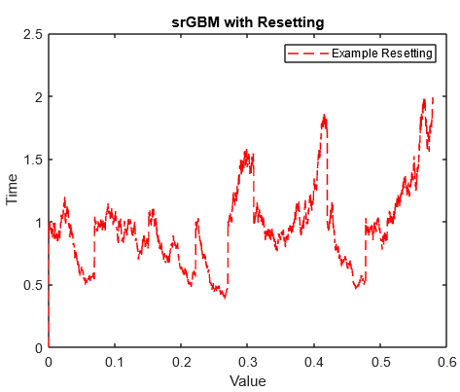
srGBM
This uses the resetting formula and GBM
Simulates the starting income of 1 and the income fluctuates and resets until it hits the desired value
Notes:
Luke Explain

Slide 5
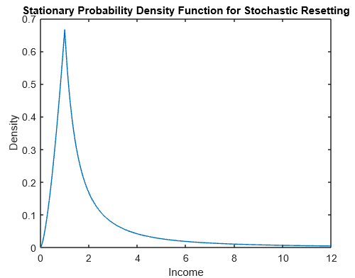
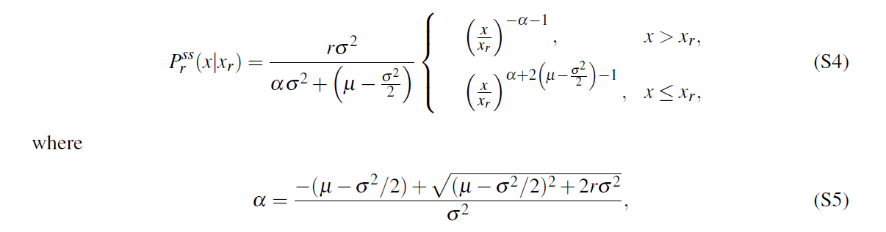
Probability Distribution Formula
This PDF describes the probability that the income is at any point x after a long time
This is called a stationary distribution with resetting (r>0) at time 𝘵→infinity.
Notes:
Ethan Explain

Slide 6
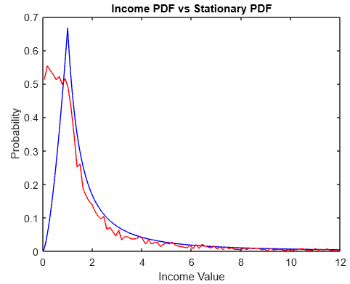
Matching PDF to Histogram Data
By simulating the path of many different incomes over an extended time period using the aforementioned srGBM function, we come up with a probability distribution very similar to the predicted PDF. Our result is shown in red.
Notes:
Luke Explain

Slide 7
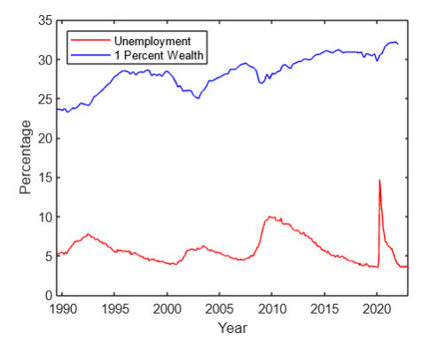
Analytical Data
Sourced our data from the same source
Unemployment data is set to the resetting rate r.
We use the previous distribution formula to find the best fit drift parameter (μ) and noise amplitude (σ) values.
We needed to match those values to the output of each year for the top 1% wealth values
Notes:
Ethan Explain

Slide 8

Using the Data
We let r(t) be the unemployment rate per year and then worked on varying the output to match the Top 1% data.
Solve numerically for mu and sigma
Notes:
Michael

Slide 9
The Results
We worked to replicate their equations and steps noted in the paper but have been unable to finish them.
We had originally hoped to have time to apply our code and the steps in the paper to other sets of data but this did not happen.
Need to finish the code that estimates the parameters mu and sigma.
We will continue working and see if we can finalize the code for the write up.
Notes:
Michael

